Slide 1
Design and Analysis of Algorithms
18CS42

Slide 2
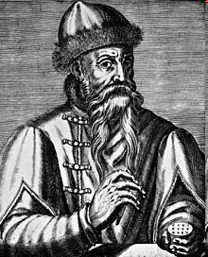
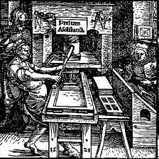
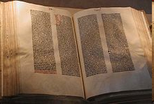
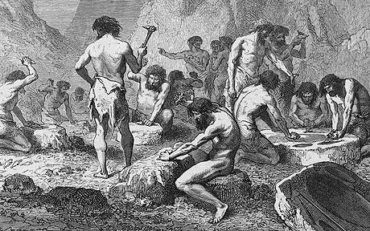
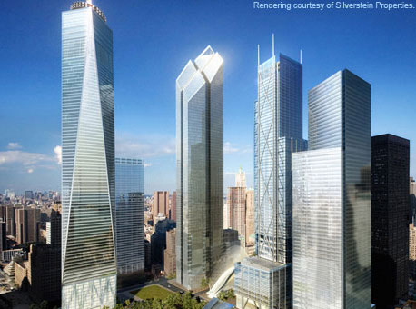
Two discoveries that changed the world !!
Johannes Gutenberg (1398 - February 3, 1468)

Slide 3
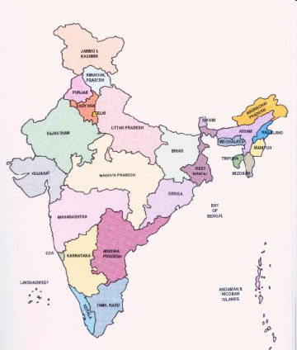
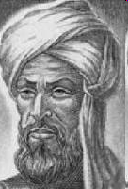
Two discoveries that changed the world !!
Decimal System invented in India around 600AD
Al Khwarizmi (780 AD – 850 AD) from Baghdad laid out basic methods for adding, subtracting, multiplication and dividing numbers
These procedures were precise, unambiguous, mechanical, efficient, correct
In short they were called Algorithms (a term coined to honor Al Khwarizmi - algorithm stem from Algoritmi, the Latin form of his name)

Slide 4
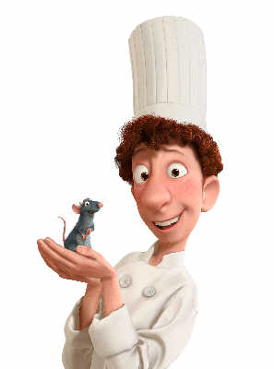

What is an algorithm?
A clearly specified set of simple instructions to be followed to solve a problem
Takes a set of values, as input and
produces a value, or set of values, as output
May be specified
In English or Hindi or Telugu
As a computer program
As a pseudo-code
Input
Algorithm
Output

Slide 5

Some Vocabulary with an example
Problem: Sorting of given keys
Input: A sequence of n keys a1, . . . , an.
Output: The permutation (reordering) of the input sequence such that a1 ≤ a2 ≤ · · · ≤ an−1 ≤ an.
Instance: An instance of sorting might be an array of names, like {Mike, Bob, Sally, Jill ,Jan}, or a list of numbers like {154, 245, 568, 324, 654, 324}
Algorithm: An algorithm is a procedure that takes any of the possible input instances and transforms it to the desired output.

Slide 6


Which algorithm is better?
Who is topper in DS?
Algorithm 1:
Sort A into decreasing order
Output A[1].
Algorithm 2:
int i;
int m = A[1];
for (i = 2; i <= n; i ++)
if (A[i] > m)
m = A[i];
return m;
Which is better?

Slide 7



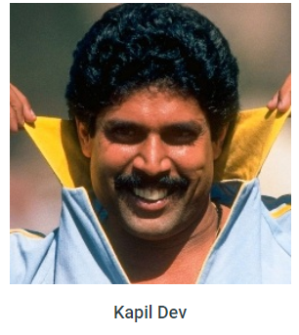
Who’s the champion?

Slide 8
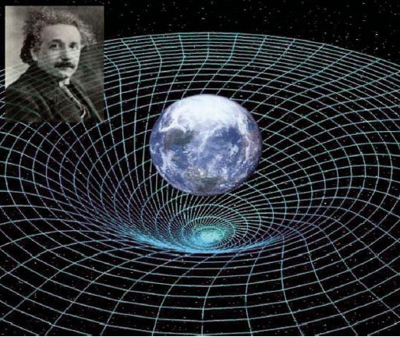
“Better” = more efficient
Time
Space
Measure efficiency (asymptotic notation)
O(n)
o(n)
Ω(n)
Ө(n)

Slide 9

Sorting Algorithms
Comparison Based
Bubble Sort
Quick Sort
Insertion Sort
Merge Sort
Heap Sort
3
7
9
17
5
2
21
18
33
4
17
9
7
5
3
33
21
18
4
2
Non-Comp Based
Radix Sort
Bucket Sort
?
Randomized
Quick Sort
33
21
18
17
9
7
5
4
3
2
Lower bound on comparison based algorithms

Slide 10
Data Structures
Name of array (Note that all elements of this array have the same name, c)
c[0]
-45
Array
c[1]
6
Linearly Ordered Set
c[2]
0
c[3]
72
c[4]
1543
c[5]
-89
c[6]
0
Head
Linked List
c[7]
62
node
node
c[8]
-3
Data
Next
Data
Next
c[9]
1
c[10]
6453
c[11]
78
object2
object
Position number of the element within array c

Slide 11
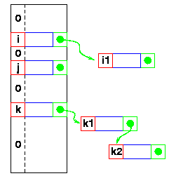
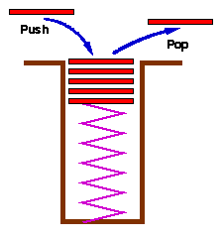
Data Structures
Hash Tables
Stack
Set with delete operation specified (LIFO)
Queue
Remove (Dequeue)
Insert (Enqueue)
front
rear

Slide 12
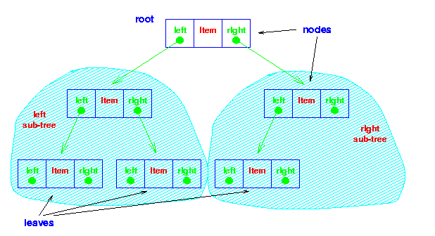
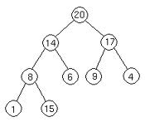

Data Structures
Binary Tree
Heap
26
17
41
Red Black Tree
14
21
30
47
10
16
19
23
28
38
7
12
15
20
35
39
3

Slide 13
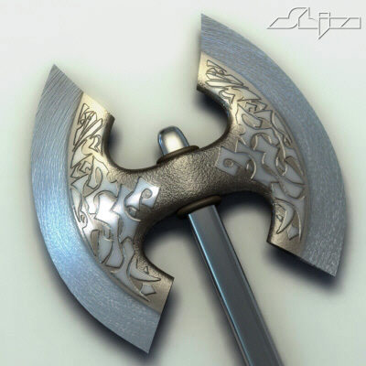
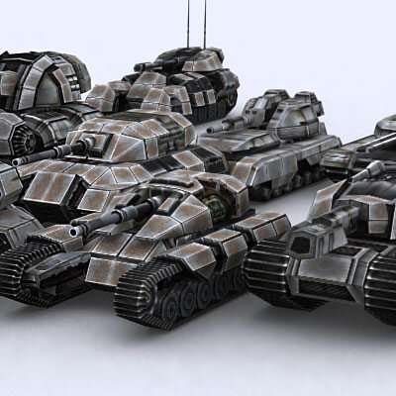


Algorithm Techniques – Divide and Conquer
Matrix Multiplication
Nearest Points

Slide 14
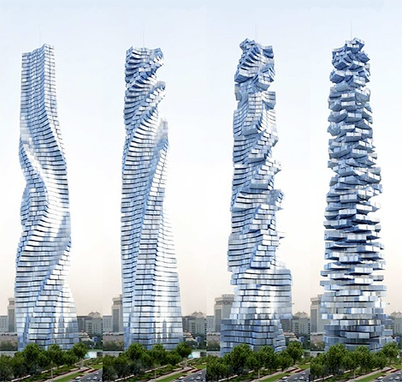
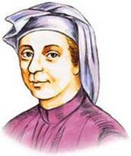
Algorithm Techniques – Dynamic Programming
Efficient algorithm
to compute F(n)
Leonardo Fibonacci
1170-1250

Slide 15
Algorithm Techniques – Dynamic Programming
Matrix Chain Product

Slide 16
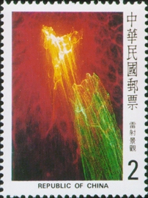



Algorithm Techniques – Dynamic Programming
If the postage is n, what is the minimum number of stamps to cover the postage?

Slide 17

Algorithm Techniques – Greedy Approach
Krusal’s Minimum Spanning Tree Algorithms
8
10
14
10
14
1
3
5
7
1
3
5
7
7
3
7
4
6
3
2
4
12
6
2
2
4
6
8
2
4
6
8
9
Prim’s Minimum Spanning Tree Algorithms
8
10
14
10
14
1
3
5
7
1
3
5
7
7
3
7
4
6
3
2
4
12
6
2
2
4
6
8
2
4
6
8
9

Slide 18
Algorithm Techniques – Greedy Approach
Task Selection Problem: Selecting as many disjoint tasks as possible.

Slide 19
Graph Algorithms
u
3
2
2
Shortest Path Algorithms:
Dijkstra’s,
Floyd-Warshall’s
All Pairs Shortest Path Algoirthm
1
1
3
-3
1
v
2
MST Algorithms:
Borůvka,
Kruskal & Prim (emphasis on Greedy approach )
Graph Search Methods:
BFS
DFS

Slide 20
P, NP, NP-Complete, NP Hard
Complexity Class P
Set of all decision problems (or languages) that can be solved in polynomial time
Complexity Class NP
Set of all decision problems (or languages) that can be verified by a polynomial-time algorithm
NP-completeness
A language L is NP-complete if
L is in NP and
All other languages in NP are polynomially reducible to L
NP-hard
A language L is NP-hard if
All other languages in NP are polynomially reducible to L
NPC
NP
P

Slide 21
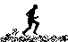
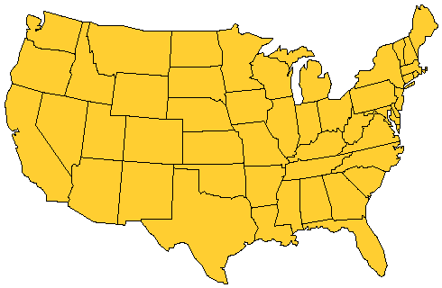
P, NP, NP-Complete, NP Hard
Home city
Visit city
Notes:
Once a month the salesperson starts from home and visits each city in his/her territory once. When done, the salesperson returns home. The salesperson wishes to minimize time spent in this activity. Assuming that the time spent at each city is fixed, total time is minimized by minimizing travel time. So, a tour of minimum length is desired.

Slide 22
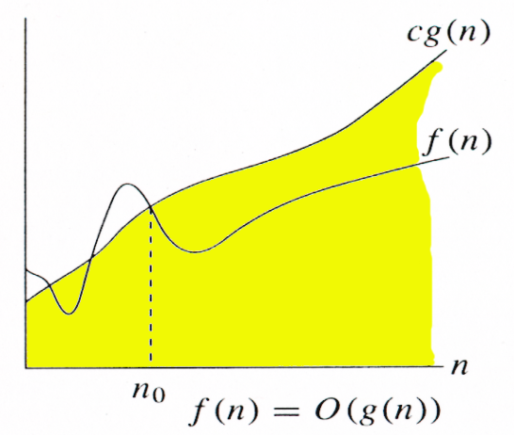
Big-Oh Notation
Given functions f(n) and g(n), we say that f(n) is O(g(n)) if there are positive constants c and n₀ such that
f(n) ≤ cg(n) for n ≥ n₀
For function g(n), we define O(g(n)), big-O of n, as the set:
O(g(n)) = {f(n) : ∃ positive constants c and n_{0,}
such that 0 ≤ f(n) ≤ cg(n) ∀n ≥ n₀ }
Example
O(n²) = {2n² + 10n + 2000, 125n² – 233n - 250, 10n + 25, 150, …..}
Notes:
Please find the explanation in lecture notes for slide no 16,17 and 18

Slide 23
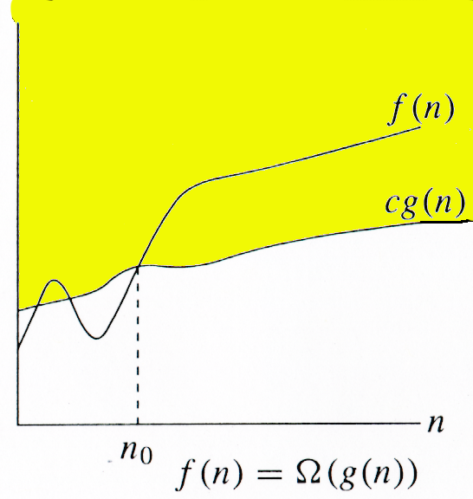
Relatives of Big-Oh (Ω(n) )
big-Omega
f(n) is Ω(g(n)) if there is a constant c > 0 and an integer constant n₀ ≥ 1 such that f(n) ≥ c•g(n) for n ≥ n₀
For function g(n), we define Ω(g(n)),
big-Omega of n, as the set:
Ω(g(n)) = {f(n) : ∃ positive constants c and n_{0,}
such that 0 ≤ cg(n) ≤ f(n) ∀n ≥ n0}

Slide 24
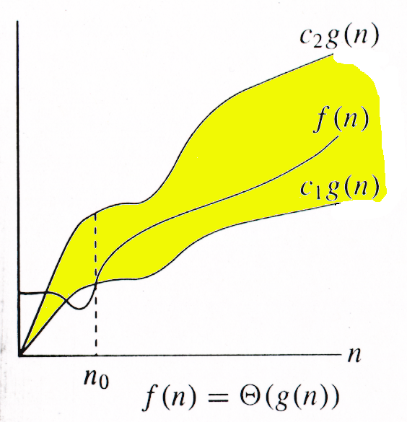
Relatives of Big-Oh (Θ(n))
big-Theta
f(n) is Θ(g(n)) if there are constants c’ > 0 and c’’ > 0 and an integer constant n₀ ≥ 1 such that c’•g(n) ≤ f(n) ≤ c’’•g(n) for n ≥ n₀
If f∈O(g) and g∈O(f), then we say
“g and f are of the same order” or
“f is (exactly) order g” and
write f∈Θ(g).
For function g(n), we define Θ(g(n)),
big-Theta of n, as the set:
Θ(g(n)) = {f(n) : ∃ positive constants c₁, c₂, and n_{0,} such that ∀n ≥ n₀,we have 0 ≤ c₁g(n) ≤ f(n) ≤ c₂g(n)}

Slide 25
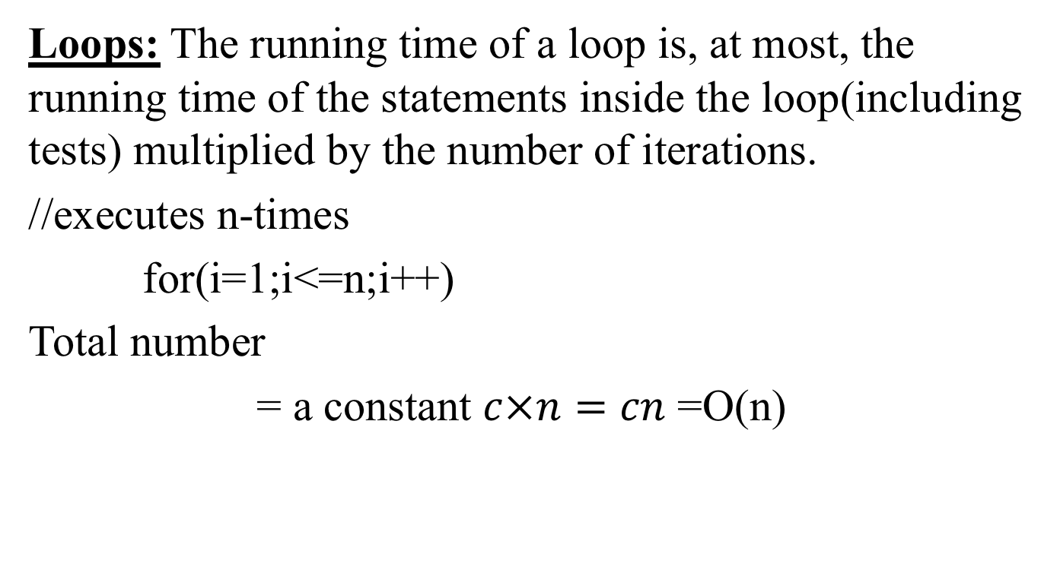
General rules to determine running time of algorithm
Loops: The running time of a loop is, at most, the running time of the statements inside the loop(including tests) multiplied by the number of iterations.
//executes n-times
for(i=1;i<=n;i++)
Total number
= a constant $c×n=cn$ =O(n)

Slide 26
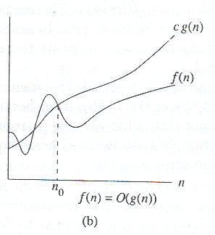
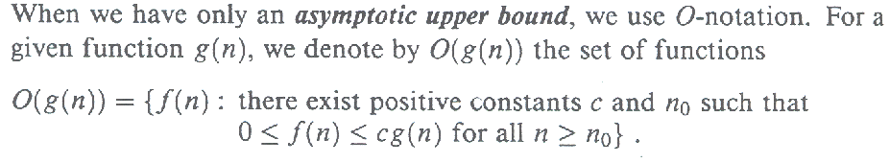
Ο − Asymptotic upper bound

Slide 27
O(big oh ) Notation:
A function f(n) is said to be in O g(n), denoted
as f(n) € O (g(n)), if f(n) is bounded above
some constant multiple of g(n) for all large n,
i.e ., if there exist some positive constant c &
some non negative integer ‘n_{o}’ such that,
f(n) ≤ c.g(n) for all n≥n₀

Slide 28
The definition is illustrated in the fig,
c.g(n)
f(n)
n_{o} n

Slide 29
Examples: Big O notation.
Given f(n) = 3n + 2, prove that f(n) € O(n).
Solution: First we have to compute c and n_{o},
By definition,
3n+2 <= c . n for n >= no
f(n) g(n)
Dividing both sides by n
3 + 2/n <= c for n >= n_{o}
Setting n_{o} = 1, we get c >= 5
now we can say that 3n + 2 <= 5n, for n >= 1.
Now, 3.1 + 2 <= 5.1, for n = 1
3.2 + 2 <= 5.2, for n =2. hence the proof.

Slide 30
More Big-Oh Examples
7n-2
7n-2 is O(n)
need c > 0 and n₀ ≥ 1 such that 7n-2 ≤ c•n for n ≥ n₀
this is true for c = 7 and n₀ = 1
3n³ + 20n² + 5
3n³ + 20n² + 5 is O(n³)
need c > 0 and n₀ ≥ 1 such that 3n³ + 20n² + 5 ≤ c•n³ for n ≥n₀
this is true for c = 4 and n₀ = 21
3 log n + 5
3 log n + 5 is O(log n)
need c > 0 and n₀ ≥ 1 such that 3 log n + 5 ≤ c•log n for n ≥ n₀
this is true for c = 8 and n₀ = 2

Slide 31
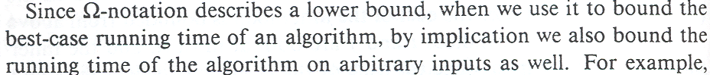
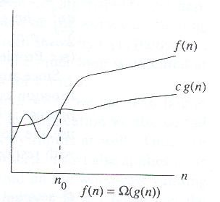
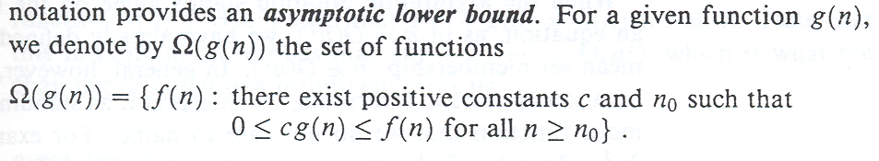
Ω − Asymptotic lower bound

Slide 32
Ω( big omega ) Notation:
A function f(n) is said to be in Ω g(n), denoted
f(n) € Ω g(n). if f(n) is bounded below by some +ve constant
multiple of g(n) for all large n,
i.e., if there exist some positive constant C and some
non- negative integer no such that,
f(n) ≥ c. g(n) for all n≥ no

Slide 33
The definition is illustrated in the fig,
f(n)
c.g(n)
no n

Slide 34
Example: Big omega notation
Given f(n) = 5 n², prove that f(n) = Ω(n).
Solution: As per the definition
5 n² >= c.n
c.n <= 5 n²
Divide both sides by n
we get, c <= 5 n
setting no = 1 results in c <= 5. there fore we can set c = 1.
5 n² >= 1.n
now, 5.1 >= 1.1 for n = 1
5.4 >= 1.2 for n = 2 Hence the proof.

Slide 35
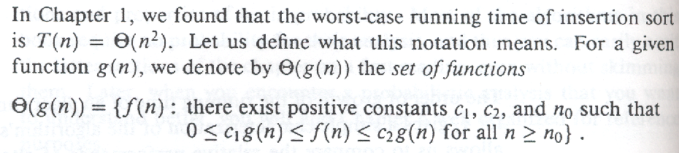
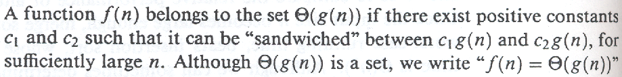
Θ − Asymptotic tight bound

Slide 36
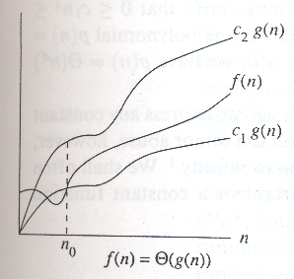
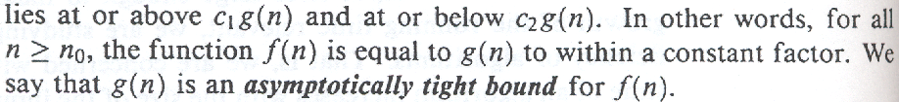
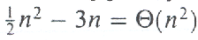
Θ − Asymptotic tight bound
Eg.

Slide 37
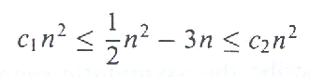
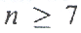
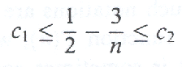
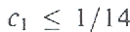
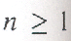
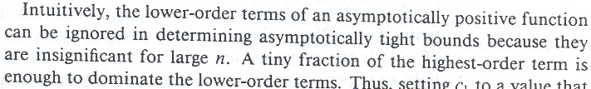
Θ − Asymptotic tight bound
Eg.

Slide 38
Transitivity property:
If f (n) = Θ (g(n )) and g (n) = Θ (h(n )) then f (n) = Θ (h(n )) .
If f (n) = Ο (g(n )) and g (n) = Ο (h(n )) then f (n) = Ο (h(n )).
If f (n) = Ω (g(n )) and g (n) = Ω (h(n )) then f (n) = Ω (h(n )) .
If f (n) = ο (g(n )) and g (n) = ο (h(n )) then f (n) = ο (h(n )) .
If f (n) = ω (g(n )) and g (n) = ω (h(n )) then f (n) = ω (h(n ))

Slide 39
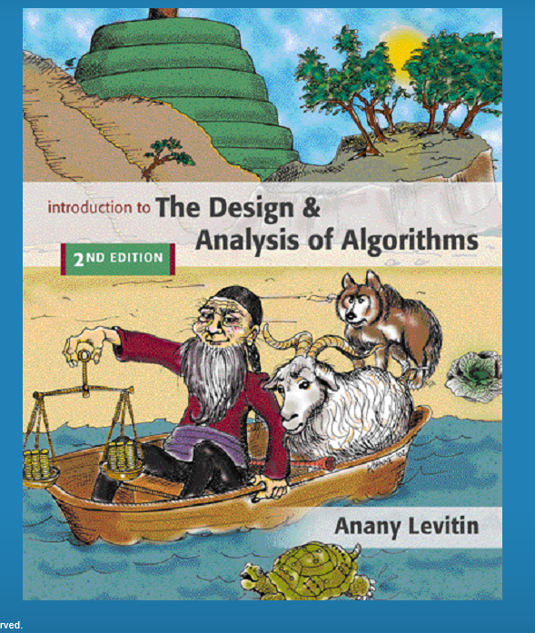

Slide 40
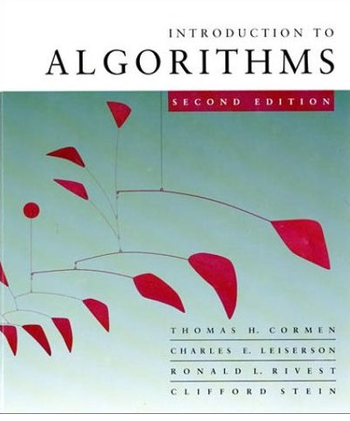




Reference Books
Also known as CLRS book

Slide 41
Thank You!!

